Slide 1

CSYE7200 PROJECT
Sentiment Analysis on Tweets
Yuan Ying - ying.yua@husky,neu,edu
Mushtaq Rizvi - rizvi.m@husky.neu.edu
Wei Huang - huang.wei3@husky.neu.edu
JinJin Zhang - zhang.jinj@husky.neu.edu

Slide 2

PROCESS REAL TWITTER DATASETS
UTILIZE TWITTER API
EXTRACT MEANINGFUL DATA
NLP(NATURAL LANGUAGE PROCESS)
PERFORM SENTIMENT ANALYSIS
PROJECT
GOAL

Slide 3


USE CASE 1
A CITY NAME
OR
A COMPANY NAME
SENTIMENT SCORE FOR
THE CITY WEATHER IN LAST 7 DAYS
OR
THE COMPANY STOCK IN LAST 7 DAYS
USER INPUT
SYSTEM OUTPUT

Slide 4
USE CASE 2
A KEYWORD
OR
NOTHING
TOP 10 POPULAR HASHTAGS FROM UPCOMING TWITTER CONTAINING THAT KEYWORD IN A 5MIN WINDOW
THE COUNT OF TWEETS AND SENTIMENT SCORE FOR EACH HASHTAG
A BAR CHART SHOWING THE RESULT*
USER INPUT
SYSTEM OUTPUT

Slide 5
USE CASE 3
A KEYWORD
OR
NOTHING
TOP 10 POPULAR LOCATIONS FROM UPCOMING TWITTER CONTAINING THAT KEYWORD IN A 10HOUR WINDOW
THE COUNT OF TWEETS AND SENTIMENT SCORE FOR EACH LOCATION
A MAP SHOWING THE RESULT*
USER INPUT
SYSTEM OUTPUT

Slide 6

ACQUIRING (SEARCH API & STREAMING API)
PARSING (JSON FORMAT)
FILTERING (LANGUAGE & GEOLOCATION)
CLEANING (SPECIAL CHARACTERS)
CALCULATING SENTIMENT (STANFORD NLP)
MAPPING & REDUCING (SPARK)
VISUALIZATION (APACHE ZEPPELIN)
METH-
ODOLOGY

Slide 7
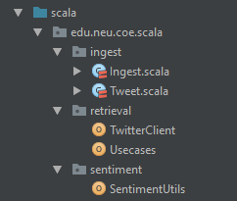

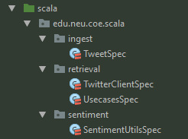
Ingest.scala
Tweet.scala
TwitterClient
Usecases
SentimentUtils
Unit Test
PROGRAMMING

Slide 8
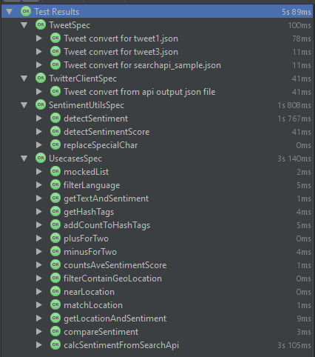
TOTAL 43 UNIT TESTS
74% CLASSES COVERED
60% LINES COVERED
UNIT
TEST

Slide 9


VERIFY ANALYSIS RESULT WITH TEST TWEETS
Included in unit test
The accuracy should reach 90%
VERITY ANALYSIS RESULT WITH KEYWORD RELATED TO WEATHER JUDGEMENT
Compare 2 city’s weather in 7 days
The accuracy should reach 70%
VERIFY ANALYSIS RESULT WITH KEYWORD RELATED TO STOCK ASSESSMENT
Compare 2 company’s stock in 7 days
The accuracy should reach 80%
ACCEPTANCE
CRITERIA

Slide 10

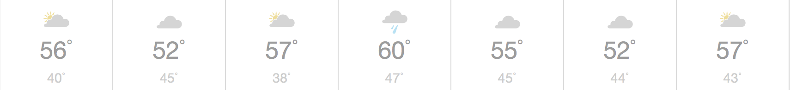


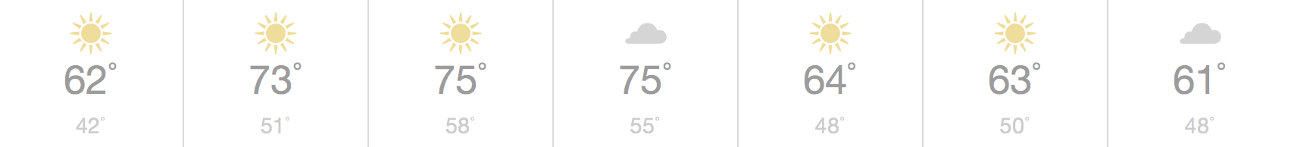

BOSTON GRADE: 1.35555556
NEW YORK GRADE: 1.41587301
PREDICTION: New York better than Boston
REAL WEATHER REPORT:
WEATHER
Boston vs. New York
90 per day per city(630 per city)
TRUTH: New York more pleasant than Boston
RESULT: accurate

Slide 11
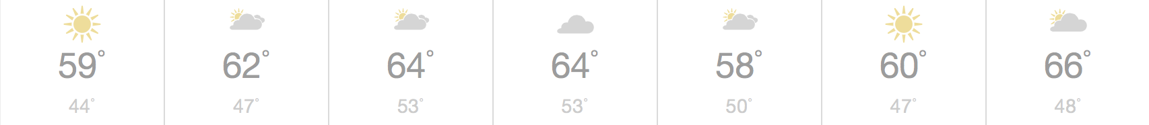
BOSTON GRADE: 1.35555556
SF GRADE: 1.20634920
PREDICTION: Boston better than San Fran
REAL WEATHER REPORT:
WEATHER
Boston vs. SF
90 per day per city(630 per city)
TRUTH: San Francisco more pleasant than Boston
RESULT: in-accurate

Slide 12

TOTAL PREDICTION ACCURACY:
8/10 = 80%
SUCCESSFULLY ACHIEVED
ACCEPTANCE CRITERIA reach 80%
WEATHER
ANALYSIS
SUMMARY
Among 10 cities over 7 days

Slide 13

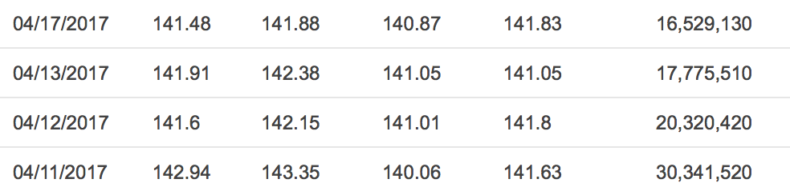
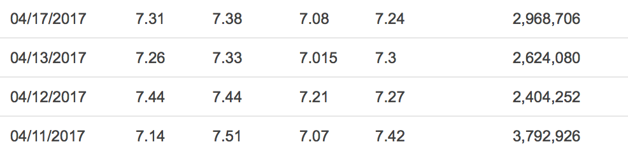
APPLE INC. GRADE: 1.09797297
GNC GRADE : 1.06976744
PREDICTION: Apple Inc. better than GNC
REAL STOCK REPORT:
DATE OPEN HIGH LOW CLOSE
STOCK
Apple Inc. vs. GNC
90 per day per company(630 per company)
TRUTH: GNC better than Apple Inc.
RESULT: in-accurate

Slide 14
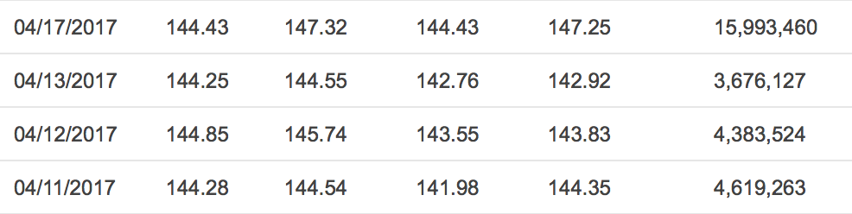
APPLE INC. GRADE: 1.09797297
Netflix GRADE : 1.41774193
PREDICTION: Netflix better than Apple Inc.
REAL STOCK REPORT:
DATE OPEN HIGH LOW CLOSE
STOCK
Apple Inc. vs. Netflix
90 per day per company(630 per company)
TRUTH: Netflix better than Apple Inc.
RESULT: accurate

Slide 15
TOTAL PREDICTION ACCURACY:
6/10 = 60%
FAILED
ACCEPTANCE CRITERIA reach 80%
STOCK
ANALYSIS
SUMMARY
Among 10 cities over 7 days

Slide 16
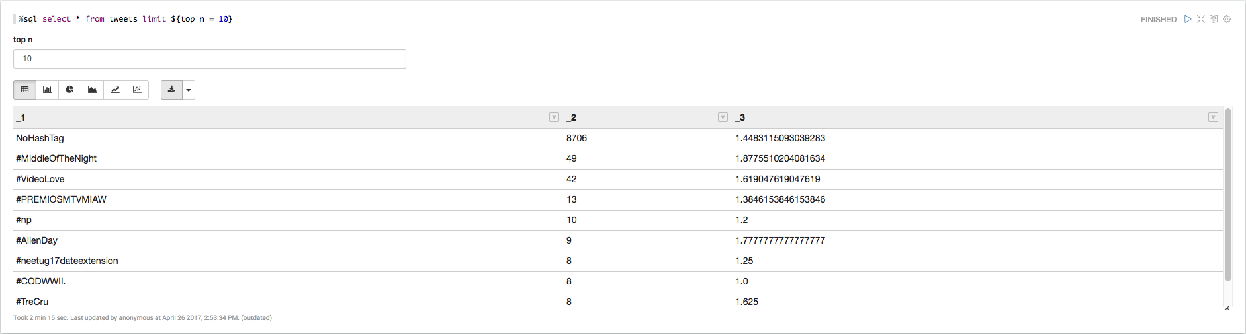

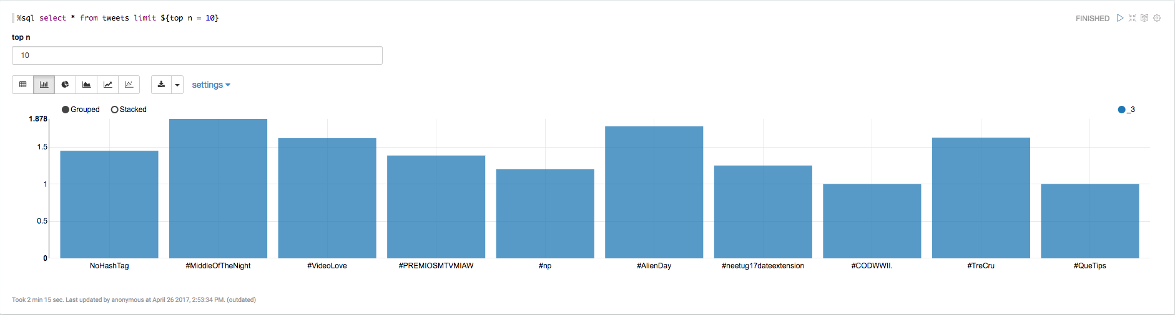
TABLE:
MOST
POPULAR
HASHTAG
5mins duration
BAR CHART:
TOTAL DIFFERENT HASHTAG COUNT: 2279
TOTAL TWEETS PROCESSED: 16896

Slide 17

SENTIMENT
MAPPING
10 hour duration

Slide 18

CODE
REPOSITORY
https://github.com/yingy4/CSYE7200_FinalProject_Team2_Spring2017

Slide 19

Course Repo
http://140dev.com/twitter-api-programming-tutorials/aggregating-tweets-search-api-vs-streaming-api/
https://www.udemy.com/apache-spark-with-scala-hands-on-with-big-data/learn/v4/overview
https://community.hortonworks.com/content/kbentry/90320/add-leaflet-map-to-zeppelin-notebook.html
https://dev.twitter.com/rest/public
https://github.com/vspiewak/twitter-sentiment-analysis/blob/master/src/main/scala/com/github/vspiewak/util/SentimentAnalysisUtils.scala
REFERENCE

Slide 20
THANK YOU!

